Slide 1


Bipedal Robot Walking using Reinforcement Learning
MA981 : DISSERTATION
Jayani Bhatwadiya
Msc. Data Science
Email: jb20998@essex.ac.uk
Department of Mathematical Science
Date : 29th September, Wednesday, 2021
Supervisors : Dr. Alexei Vernitski
Dr. Fanlin Meng

Slide 2
Introduction : Why Bipeds?
Why 2 legs ? 4 or 6 legs give more stability, don’t they?
A biped robot body can be made shorter along the walking direction and can turn around in small areas
Light weight
More efficient due to less number of actuators needed

Slide 3
Goal :
The main goal of this project is that to solve the problem characterized by the environment BipedalWalker-v2. (https://gym.openai.com/envs/BipedalWalker-v2/ )
The issues occurs when robot chooses for don’t fall and walk to the end of the path. Rewards depend on the distance travelled by robot and it is a value of continuous space.
Precisely this can be resolved when agent start to get an average reward greater than 300 for consecutive episodes.
So We want to discover a reinforcement algorithm which can be able to achieve the above goal in the possibly short time.

Slide 4
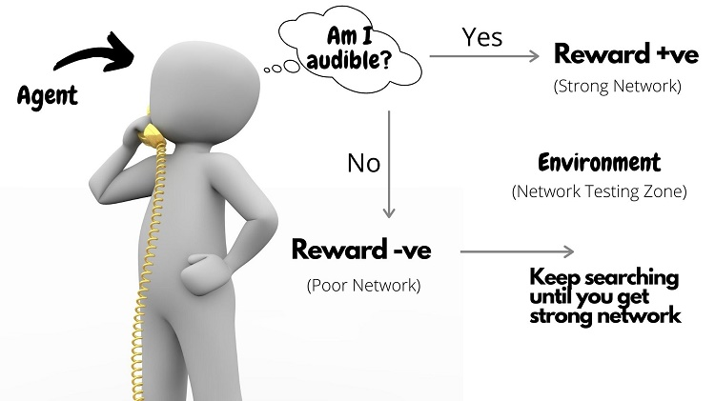
Methodology : Reinforcement Learning

Slide 5
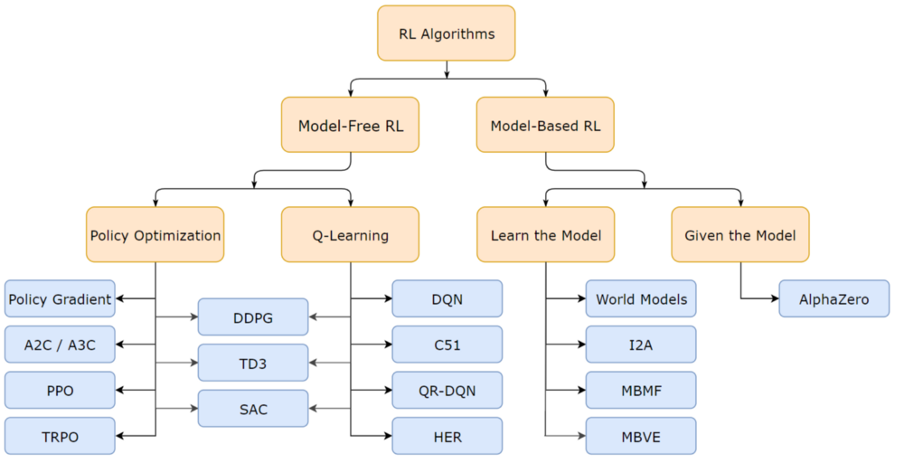
Taxonomy of RL Algorithms :

Slide 6
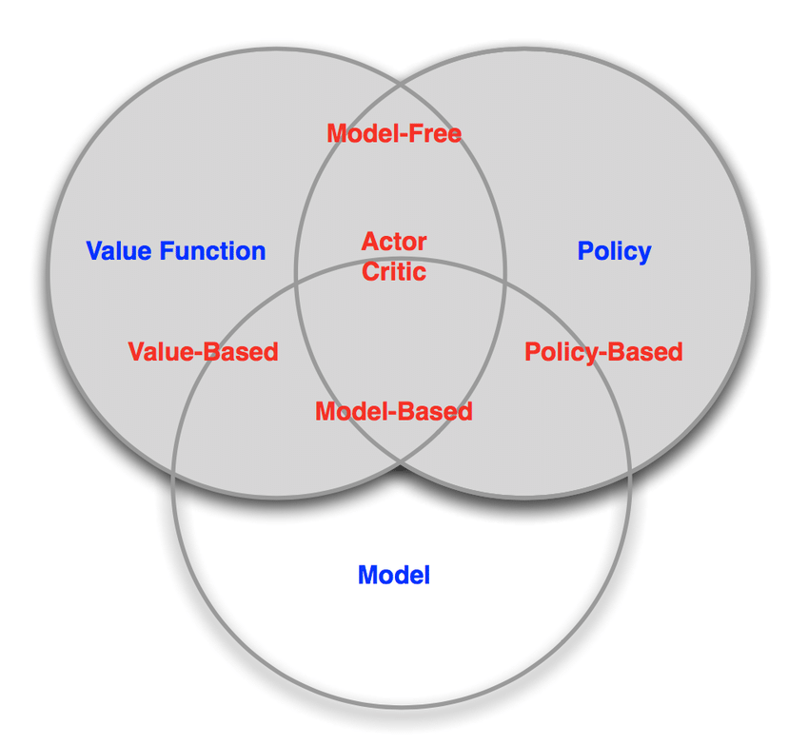
Why Actor–Critic Approach?

Slide 7
Algorithms Used:
1) Deep Deterministic Policy Gradient (DDPG)
Deep Deterministic Policy Gradient (DDPG) is a reinforcement learning technique that combines both Q-learning and Policy gradients.
A DDPG agent is an actor-critic reinforcement learning agent that searches for an optimal policy that maximizes the expected cumulative long-term reward.
Generally used in continuous control problem such as Robotics problems.

Slide 8
DDPG Key features :
Actor - It proposes an action given a state.
Critic - It predicts if the action is good (positive value) or bad (negative value) given a state and an action.

Slide 9
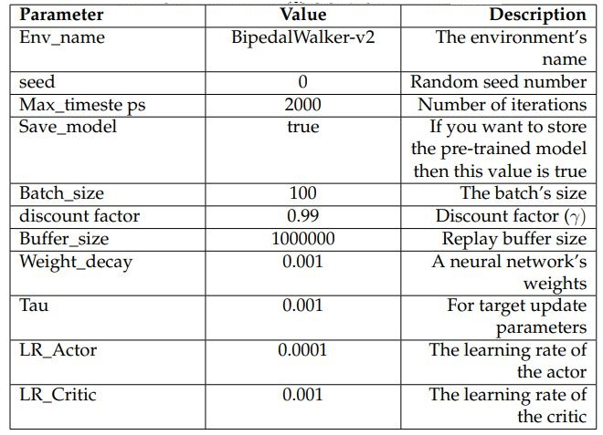
DDPG Implementation:
1.
Initialise replay buffer
2.
Initialise networks
3.
Store transitions
4.
Update critic
5.
Update actor
6.
Update target networks
7.
Repeat until sentient

Slide 10
2) Twin Delayed Deep Deterministic Policy Gradients (TD3)
TD3 is the successor to the Deep Deterministic Policy Gradient (DDPG)
Generally used in continuous control problem such as Robotics problems.
Inception on TD3 : DDPG worked well but it continuously over estimated the Q values of the critic ( value ) network. This errors accumulates and agent could get stuck in local minima or can experience catastrophic forgetting.

Slide 11
TD3 Key Features :
Actor : TD3 uses a delayed update of the actor network, only updating it every 2 time steps instead of after each time step, resulting in more stable and efficient training.
Twin Critic Network : TD3 uses two separate critic networks, it uses small value among this two critic values while forming targets.

Slide 12
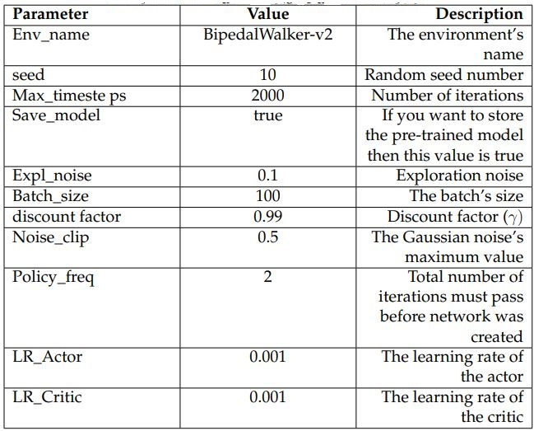
TD3 Implementation:
1.
Initialise networks
2.
Initialise replay buffer
3.
Select and carry out action with exploration noise
4.
Store transitions
5.
Update critic
6.
Update actor
7.
Update target networks
8.
Repeat until sentient

Slide 13
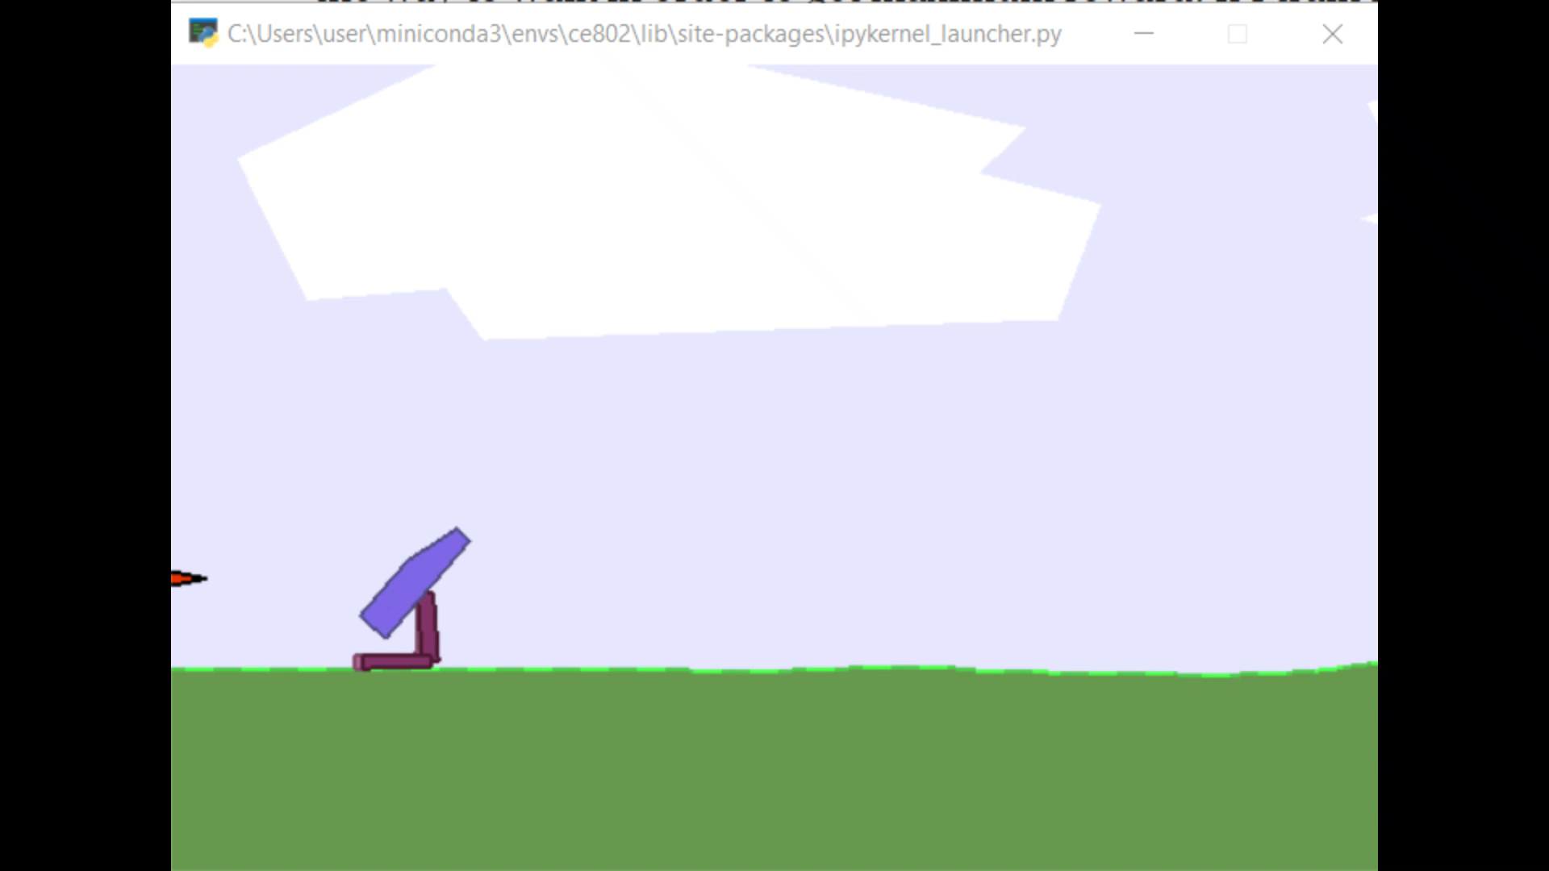
Training Process & Demo :
200 episodes In start of training agent picks Staying in a same place instead of moving away due to high negative rewards.

Slide 14
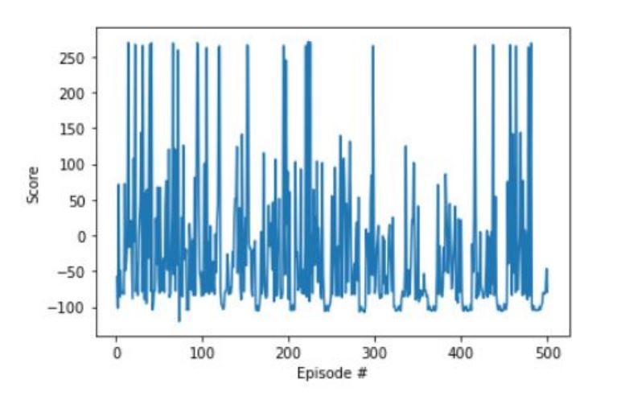
DDPG Evaluation :
Around 250 scores in 500 Episodes.

Slide 15
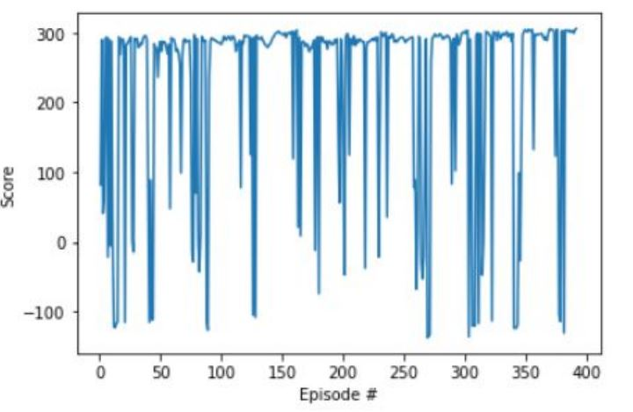
TD3 Evaluation :
Reaches 300 Scores in 400 Episodes.

Slide 16
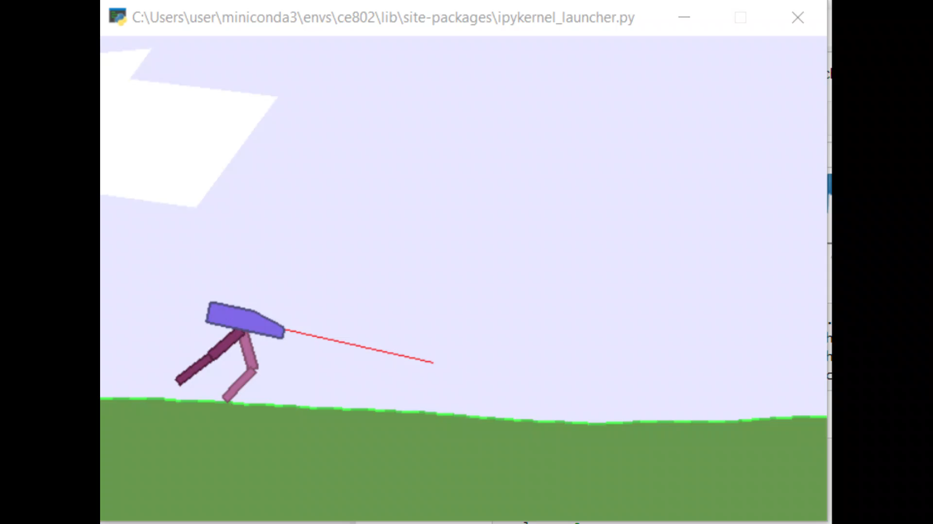
Result :
1500 episodes Rewards converge to more than 300 values.

Slide 17
Conclusion and Future Work :
TD3 is capable of providing excellent results compare to DDPG.
Using a higher-performance computer, GPUs and TPUs.
Transfer learning can be used to increase an agent’s performance.
Evaluating performance of this study with simulator like Mujoco, Gazebo and Pybullet.
The study of other algorithms, such as SAC, TRPO, and PPO.
Experiment this study using OpenAI Baseline algorithms.

Slide 18


